Slide 1
Memoarrr!

Slide 2
Agenda
Rules of the game
Demonstration of the app
Explanation of the model

Slide 3



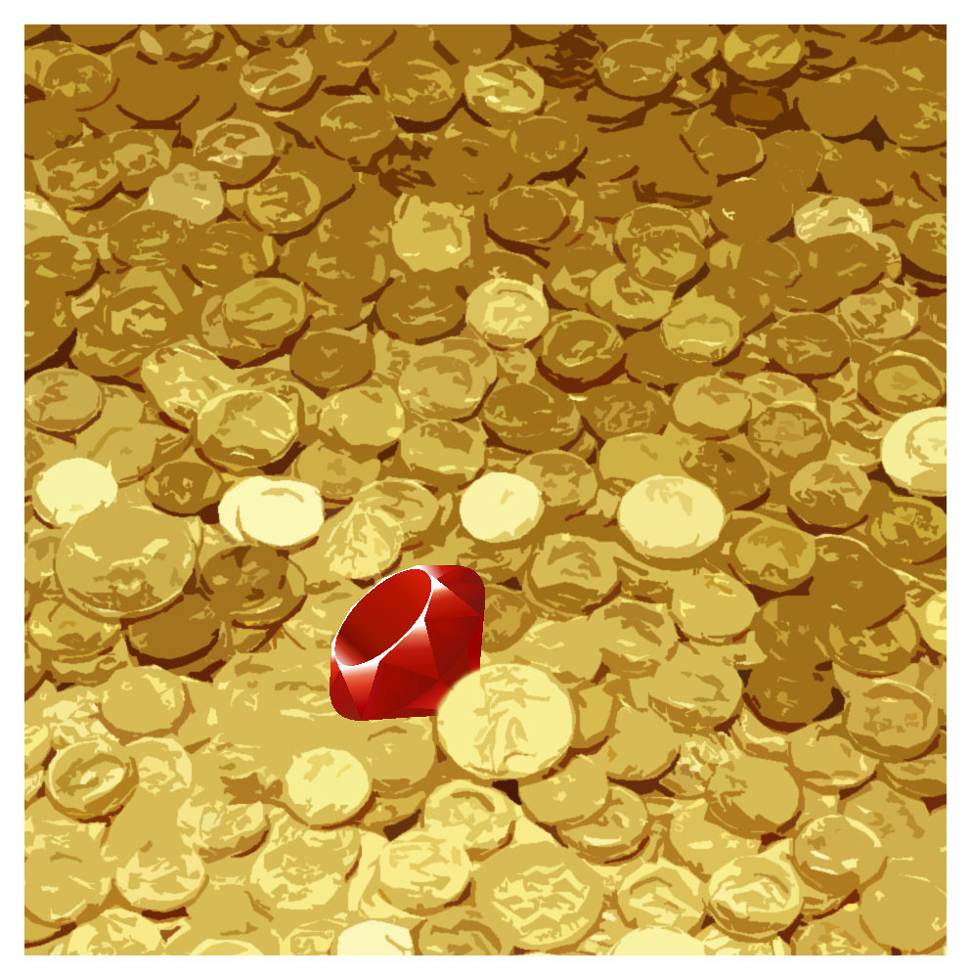




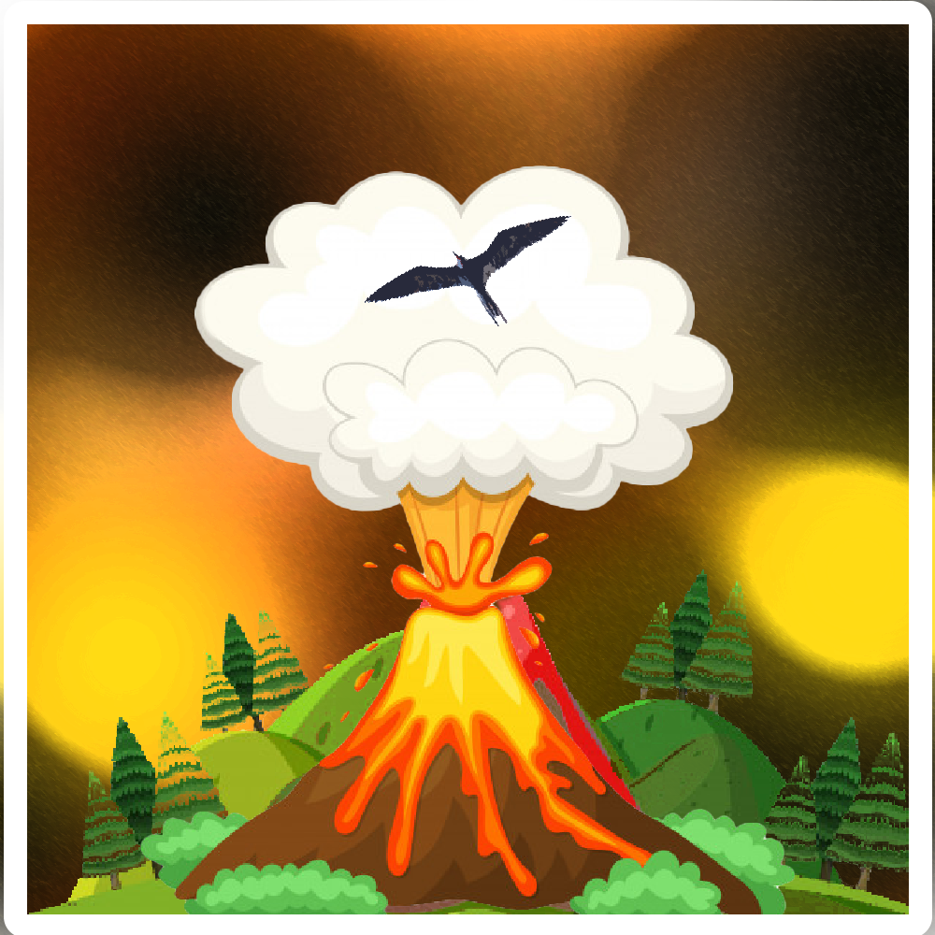
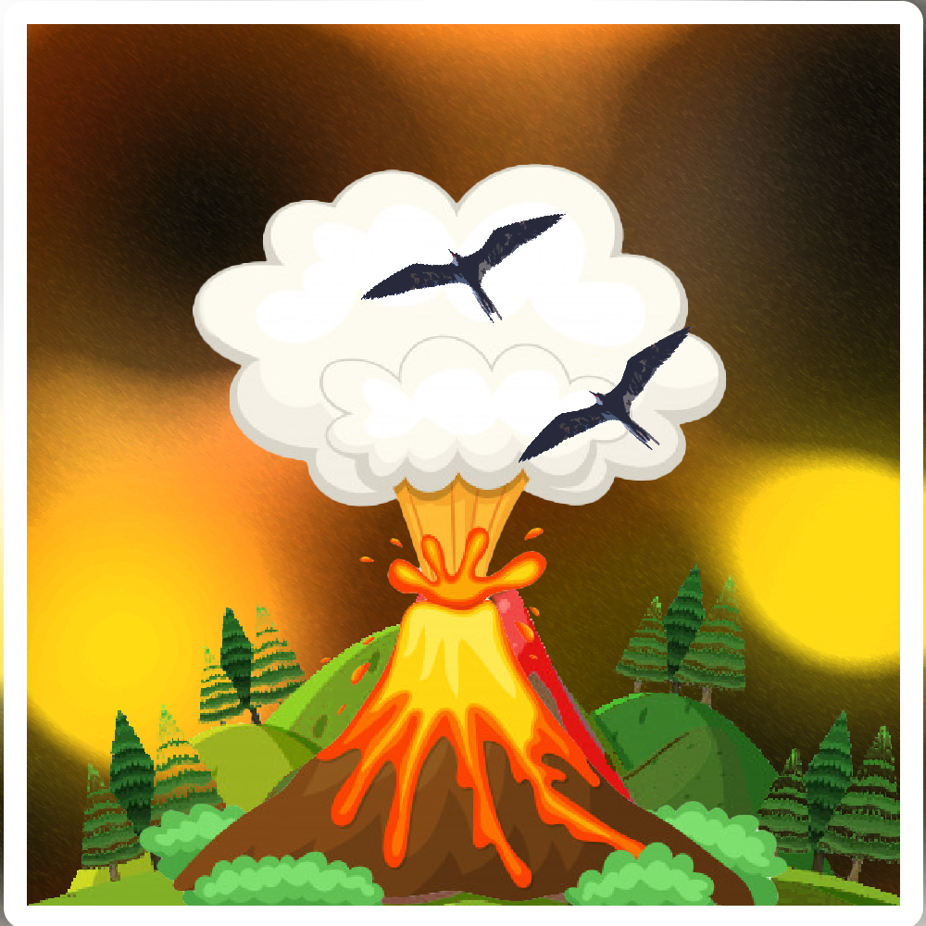




Slide 4
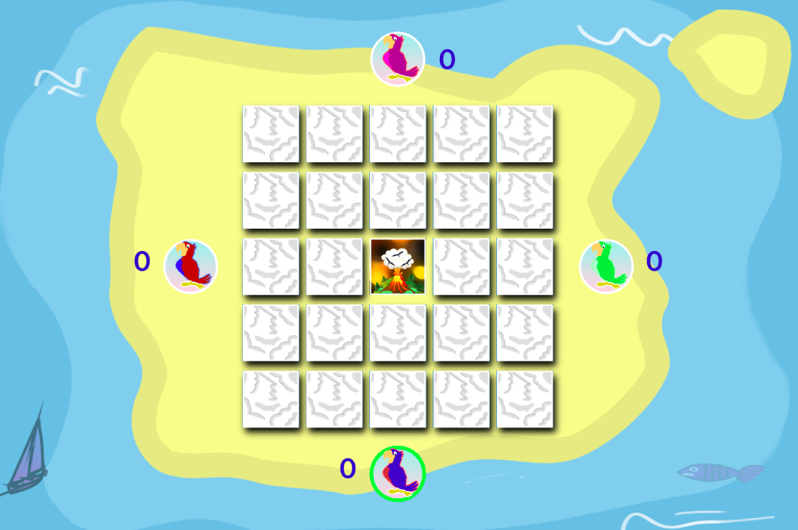


Slide 5



Slide 6


Slide 7


Slide 8



Slide 9


Slide 14


Slide 18
The model
Notes:
Thank you. Now I am to talk to you a bit about the inner mechanism of our model and how all of the pieces combined enables it to play the game accurately.

Slide 19
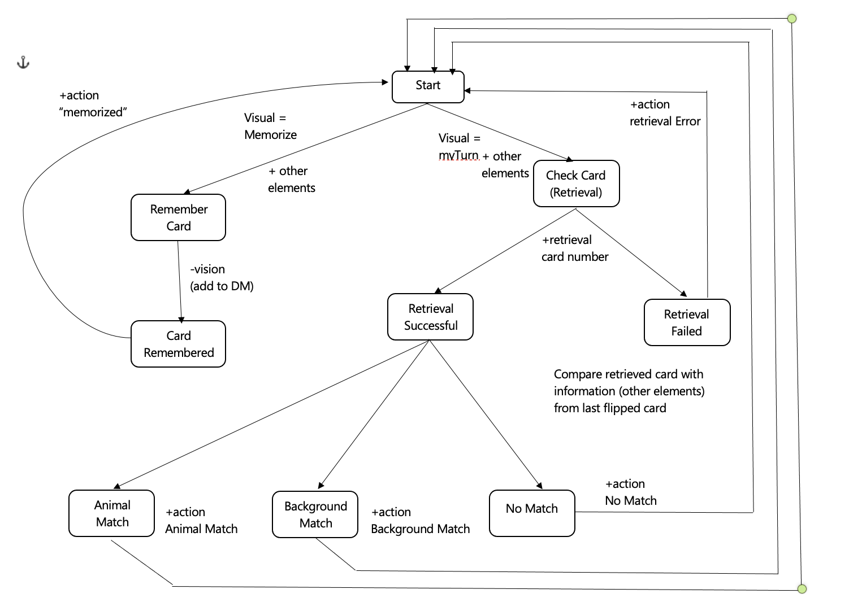
The Model
Notes:
As everything in the world, our model has a start point. There, the model gets initialized, and responds back to the code that initialization is complete.

Slide 20
The Model
Notes:
At this point, the model has only two paths. One is for memorizing cards that get flipped by the other players and is not yet the model’s turn.

Slide 21
The Model
Notes:
Or is the model’s turn and it has to check whether it can remember some card that matches the last flipped card.

Slide 22
The Model
Notes:
But for now, let’s focus on memorizing cards.

Slide 23
The Model
Notes:
That is done rather easy. In the visual buffer, I also have card information like background type and animal type. So by simply clearing the buffer, it gets into DM.

Slide 24
The Model
Notes:
Now the information got stored in the DM, and the model responds with an action, so that we know it memorized the card correctly.

Slide 25
The Model
Notes:
Now on the other side, it’s the model’s turn to flip a card, hence it will take all cards (in random order, to try to produce a more human-like experience) one by one.
For each card, it tries to do a retrieval request based on that card’s number (representing the card’s position).

Slide 26
The Model
Notes:
If the retrieval failed, the model will respond with an action, that way we know the model doesn’t have any information on that specific card.

Slide 27
The Model
Notes:
If the model managed to retrieve information about that specific card, it means it should have knowledge regarding the animal and the background.
So the model is now going to compare the retrieved information with the last flipped card information.

Slide 28
The Model
Notes:
Based on what kind of match is there, the model will respond accordingly.

Slide 29
The Model
Notes:
Therefore, through an action, the model will respond whether the card at some position it remember it matched the animal, the background or neither.

Slide 30


Slide 31
Strategy
Implemented:
When no card returned an animal or a background match, turn a card that is not stored in the DM (instead of a random one)

Slide 32
Strategy
Implemented:
When no card returned an animal or a background match, turn a card that is not stored in the DM (instead of a random one)
Interesting to implement:
Turn a card based on what has been already flipped and based on DM; get some sort of ranking of the match and decide on the best one, strategy wise

Slide 33


